Slide 1

Watchdog
Automated System Design
Last Updated: January, 2011

Slide 2
Interactive Features – Normal Mode
Event | Action | Comment
External Door Opened | Play Door_Opened.wav
External Door Closed | Play Door_Closed.wav
External Door Unlocked | Play Door_Unlocked.wav
External Door Locked | Play Door_Locked.wav
Garage Door Opened | Play Gdoor_Up.wav Garage coach lights turn on for 15 minutes | Coach lights only turn on between 7PM and 7AM
Garage Door Closed | Play Gdoor_Down.wav
Upstairs Hallway Motion Detected | Play Motion_Detected.wav | Sound only played between the hours of 9PM and 7AM
Mail Delivered | Speak “You’ve Got Mail”
External Door left open for 1 minute | Speak “Attention, Please close the ??? Door“.” | Mudroom door waits 3 minutes to allow loading/unloading of the cars
Average house temperature > 85 F | Speak “Is it just me, or is it hot in here?” | Checks hourly
Average house temperature < 65 F | Speak “Is it just me, or is it cold in here?” | Checks hourly
Garage Door open for 10 minutes and Garage Temperature < 45 F | Speak “Attention, Please close the Garage Door” | Repeats every 10 minutes.
Return to house after being unoccupied for more than 5 minutes | Speak “Welcome home. While you were gone, you missed X Phone calls, Y Visitors, and the mail was delivered.” Speak “While you were gone, nothing interesting happened” | Message adjusted depending on the events that occurred while the house was unoccupied
Time is between 12AM and 4AM, and no motion is detected in the Great Room | Turn Great Room Light off | Repeats every hour during the 4 hour interval.

Slide 3
Interactive Features – Normal Mode
Event | Action | Comment
A car departs | Check external door locks and send SMS Text message to car owner notifying which door lock is opened
A car departs and no motion is detected for 5 minutes | Set house status to “Unoccupied” Adjust thermostat Turn off lights | If garage temp < 70 F, raise Thermostat temp by 2 degrees. If garage temp > 65 F, lower Thermostat temp by 2 degrees.
Car arrives when house is Unoccupied | Set house status to “Occupied” Adjust thermostat If after 7PM, turn lights on | Adjust thermostat back to original temp prior to departure.
Motion detected when house is Unoccupied | Set house status to “Occupied” Adjust thermostat | Adjust thermostat back to original temp prior to departure.
Lizard habitat temperature falls below 83 F | Speak “Attention the lizard habitat is too cold.” If house is unoccupied, send SMS text message to both phones.
9:30 PM | Check security of house If necessary, speak “Attention, the following security items must be addressed…” | Repeats twice between 9:30 and 10:00pm if needed.
Water softener brine tank is < 20% full | Append message to the daily 9:30PM status to include a warning that the brine tank salt level is getting low
National Weather Service issues a Thunderstorm or Tornado Warning for the area | Speak: “The weather is not looking too good. You may want to move to the basement” | Checks hourly
Doorbell rings | Front Door Coach Lights Turned On for 15 min. Play X10 doorbell chime in basement Sarah (Hallway) shows front door cam for 1 min. | Coach lights only turn on between 7PM and 7AM

Slide 4
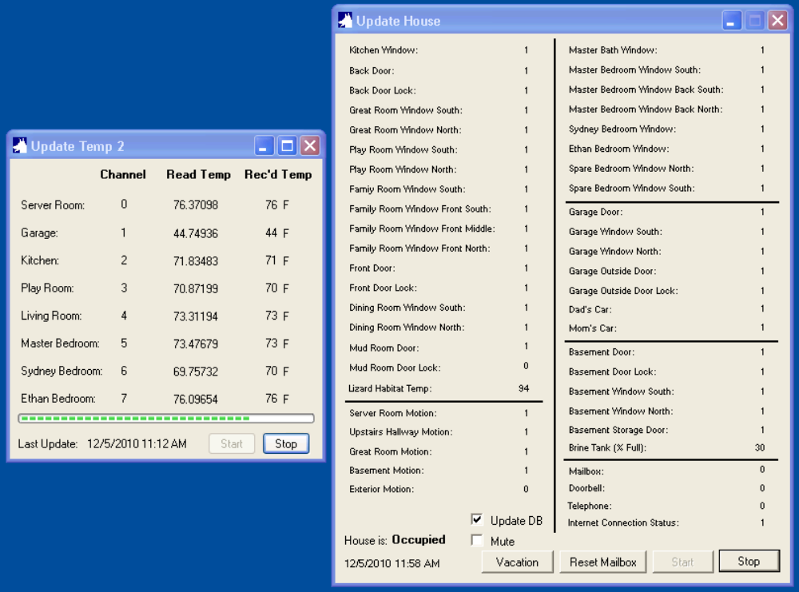
Normal Mode GUI

Slide 5
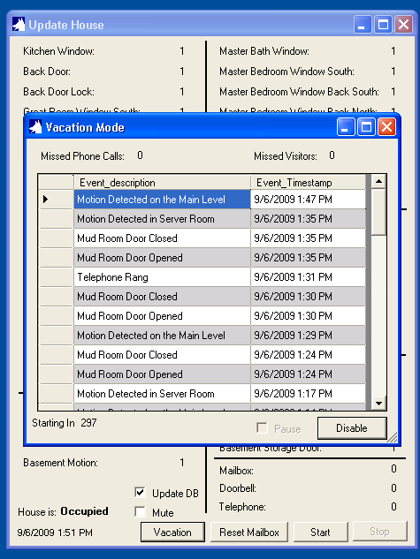
Interactive Features – Vacation Mode
Vacation Mode
Requires manual activation with a 5 minute delay timer.
Aggressively monitors motion and external doors.
Not intended for daily use. Best used when the house will
be unoccupied for at least 24 hours.
Acts as a burglar alarm using SMS text to notify
homeowners of intrusion
Provides an alternate GUI that:
  Shows the 50 most recent events
  Tracks the missed phone calls
  Tracks the missed visitors
When deactivated, provides a summary of events
that occurred while active.

Slide 6
Interactive Features – Vacation Mode
Event | Action | Comment
Vacation mode initiation activated | Begins a 5 minute delay before automatic activation
Vacation mode initiation countdown has 1 minute left | Speak “Warning, Vacation mode will activate in 1 minute”
Vacation mode initiated and car departs | Send SMS text message with a list of external door/window status
Vacation mode initiated | Send SMS text message confirming Vacation Mode is active.
Vacation Mode Activated
Event | Action | Comment
Motion detected or external door opened | Sends SMS text message to both phones Plays a loud warning horn and speaks a warning that the owners have been notified | Sleeps for 1 hour, to avoid sending updates too frequently
Random times in the evening | Turn on lights | Give the appearance of inhabitance for burglars watching the house.
Random times at night | Turn off lights | Give the appearance of inhabitance for burglars watching the house.

Slide 7
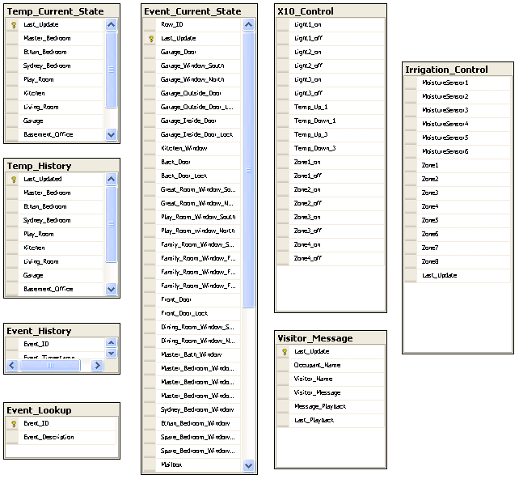
Data Model
Tables:
Temp_Current_State: Holds the most recently read temp values (1 rows)
Temp_History: Holds the last 24 hours of temp values
Event_Current_State: Holds the most recently read house status values (2 rows)
Event_History: Holds 1 month of Event History
Event_Lookup: Static lookup of Event ID values to text
X10_Control: Allows any app to trigger an X10 command from the Watchdog server.
Visitor_Message: Captures the recorded message from front door visitor.
Irrigation_Control: Holds the state of the soil moisture sensors and sprinkler zone values.
Triggers:
Temp_Current_State_Archive: On Update, Takes the most recently read temp values in Temp_Current_State and inserts them in Temp_History. Also, deletes rows in Temp_History older than 24 hours.
Event_Current_State_Archive: On Update, Takes the changed data from Event_Current_State and inserts a row into Event_History.
Event_History_Purge: On Insert, deletes all the rows older than 1 month.
Temp_Alert: On update, checks for high/low temperature values
X10_Update: On update, sends the appropriate X10 command via the serial port interface.

Slide 8
Reports
SQL Server 2008 Reporting Services
Current Status Report
  Shows the current state of each sensor in the house
  Pulls from Event_Current_State
  Links to Event History Report
Event History Report
  Shows the list of the last 200 events (approx 2 – 3 days)
  Pulls from Event_History
  Links to Current Status Report
Current Temp Report
  Shows the current temp of each sensor in the house
  Pulls from Temp_Current_State
  Links to:
    Garage Temp History Report – Graph
    Kitchen Temp History Report – Graph
    Playroom Temp History Report – Graph
    Living Room Temp History Report – Graph
    Master Bedroom Temp History Report – Graph
    Sydney’s Bedroom Temp History Report – Graph
    Ethan’s Bedroom Temp History Report - Graph

Slide 9
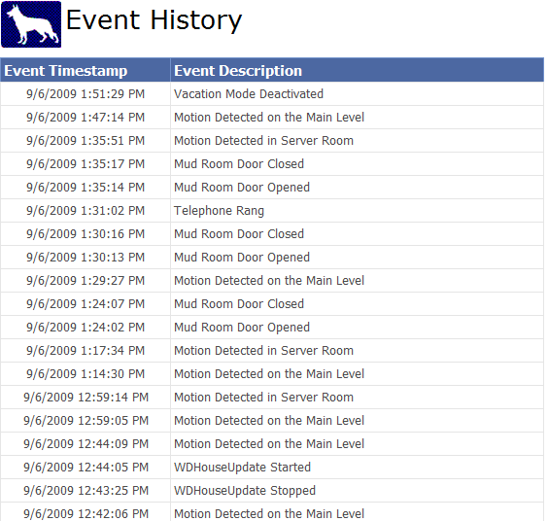
Reports – Event History Sample

Slide 10
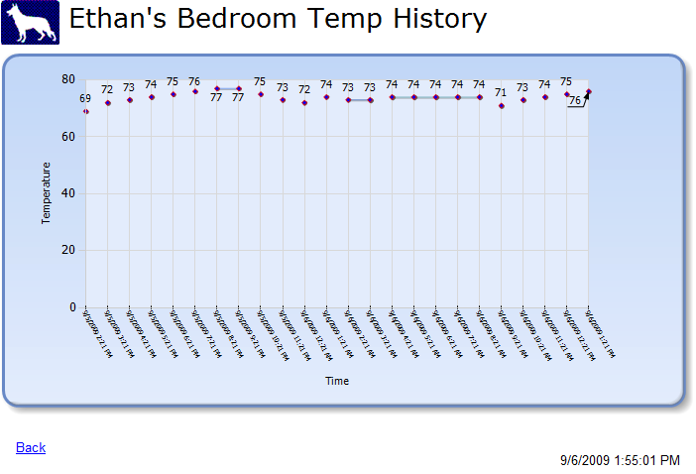
Reports – Temperature Graph Sample

Slide 11

Module Overview
S.A.R.A.H
10011010
01111000
WDSendTextMsg
WDHouseUpdate
SQL Server 2008
Reporting
Services
WDPlay_Voice
Watchdog
WDTempUpdate
WDPlay_Sound
SQL Server 2008
Express Ed.
10011010
01111000
WDX10
Reporting Service Sites:
User: http://192.168.1.202/ReportServer_WATCHDOG/
Admin: http://192.168.1.202:8080/Reports_WATCHDOG/Pages/Folder.aspx

Slide 12
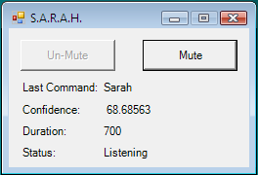
S.A.R.A.H
Self Actuated Residential Automated Habitat
Voice recognition and response system
Queries the Watchdog database and RSS XML data feeds from the Internet to answer questions about house status, house temperature and weather.
Some commands:
House Status
<name a room in the house>
Upstairs Temperature
House Temperature
What should I wear today/tomorrow?
Should I turn the water off?
Forecast
What’s the weather like?
Wake up Mom/Dad
What can I say?
Who are you?
Raise Temperature
Lower Temperature
Mailbox
I’m expecting company/visitors
Light on/off
What is the air speed velocity of a laden swallow?

Slide 13
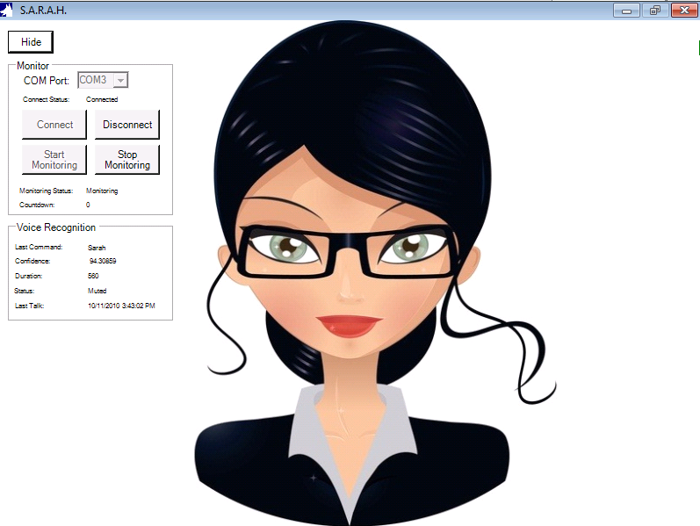
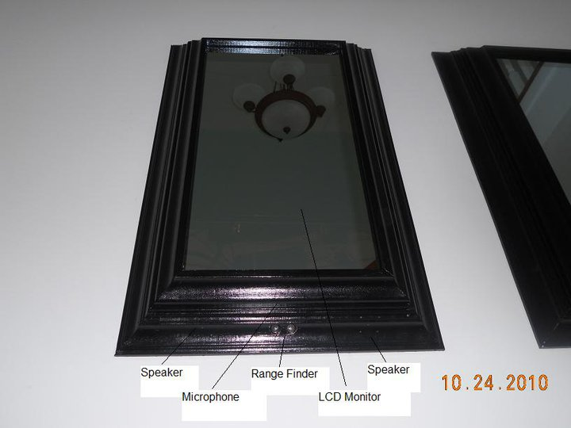
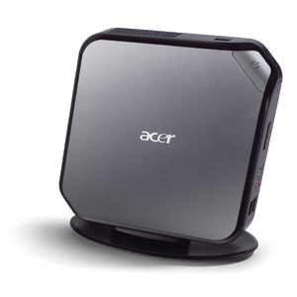
S.A.R.A.H Hallway
In the front hallway, a 2-way mirror hides a PC and monitor running SARAH. The frame is custom made with crown molding to give room to hide a PC monitor. A nook in the wall provides a shelf for the PC and other components as well as pre-wired power and network.
An Arduino connects to a PC via USB cable and provides 2 peripherals:
1. A Seeedo ultrasonic range sensor senses when someone is standing in front of the mirror.
A relay that allows the software to turn on/off the monitor.
Other devices used:
An Acer AspireRevo provides an ultra-small form-factor Windows 7 platform for running the SARAH system.
A Lenovo ThinVision USB soundbar provides the amplified speakers integrated into the picture frame.
A Gigaware Omnidirectional PC microphone is also integrated into the picture frame.
¼” thick glass 2-way mirror from hiddentelevision.com provides a great looking mirror that hides the monitor until it is turned on.
Integrates with the H.264 security camera DVR to show a view of the front door when the doorbell rings.

Slide 14
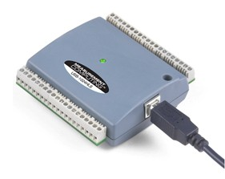
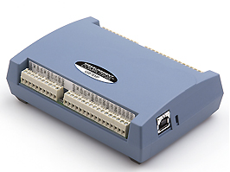
Data Input Devices
Digital IO x 2
Measurement Computing USB-1024HLS
USB bus-powered digital I/O module with 24 high-current (64 mA sink, 15 mA source) digital I/O lines
Digital Temperature:
Measurement Computing USB-TEMP
USB-based 8-channel temperature measurement module supports 4 sensor types
Cantherm Thermistor 10KΏ crimped into an RJ45 plug for modular connectivity throughout the house.

Slide 15
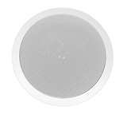
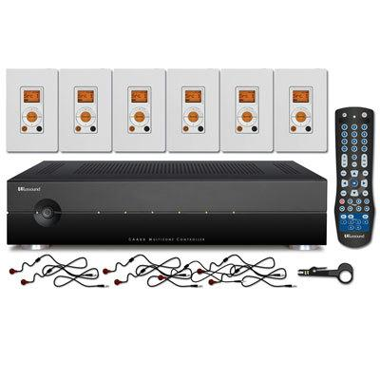
Whole-house Audio System
Russound
Provides discrete control of volume and source control to flush-mounted, stereo ceiling speakers in each room of the house. Allows switching between four different input sources.
Watchdog server audio card output is connected to the “Aux” input port of the Russound modules. Each controller is left on the “Aux” setting with the backlight turned off.
2 x Russound CA6.4i multi-room amplifiers. Each supports 6 outputs and 4 sources.
Every room has a ceiling speaker controlled by a nearby wall plate.
Controls fit into a single gang-box outlet and use CAT5 cable to connect to the rack module in the basement
  4 upstairs (one in each bedroom)
  6 on main floor
  1 in basement

Slide 16

Remote Access
Citrix Access Gateway
An SSL VPN appliance seated in a DMZ firewall configuration to allow secure, remote access for management and monitoring of Watchdog.

Slide 17
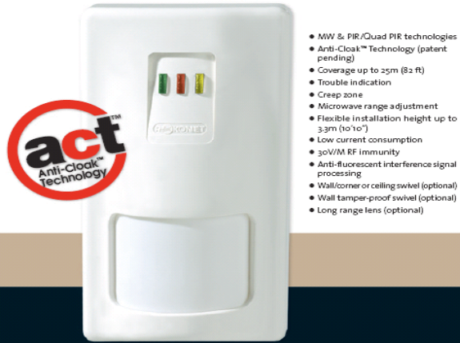
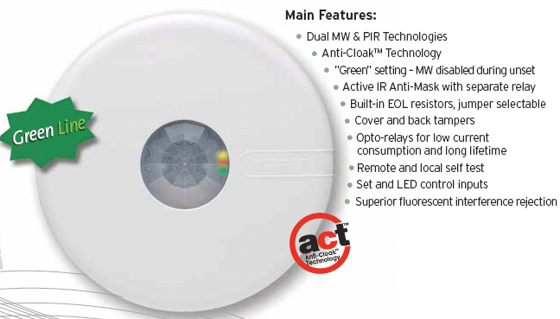
Motion Sensors
Server Room & Basement Motion Sensor:
Roconet iWise DT
Mid-range (50’) model
Dual technology (Microwave, Infrared), Dual element
Great Room Motion Sensor:
Roconet iWise DT-Quad
Mid-range (50’) model
Dual technology (Microwave, Infrared), Dual element
Anti-Cloak Technology
Upstairs Hallway Motion Sensor:
Roconet LuNAR DT - Ceiling Mount
Dual technology (Microwave, Infrared)
360° coverage
Anti-Cloak Technology

Slide 18
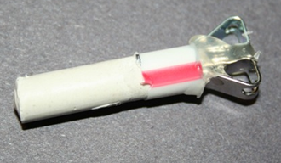
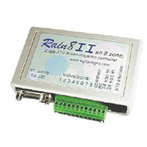
Irrigation Control
Should I run the sprinklers?
Check weather RSS feeds to determine current and near future rain probability to determine if irrigation is needed.
Check moisture sensors for current ground condition. Moisture sensors use galvanized nails embedded in “Plaster of Paris” (Gypsum) which decreases in electrical resistance when it gets wet. A custom opto-isolation circuit board is used to connect this to an Arduino board to check the values.
Check the calendar. Don’t run the sprinklers after October 30 and before March 1.
Run the sprinklers
If the checks determine that sprinklers should be run, send X10 signals to the Rain8 II – 8-zone irrigation controller.
Watchdog issues X10 signals to turn on/off irrigation zones.
Run each zone for an allotted time. Run only one zone at a time.
Uses House Code “E”

Slide 19
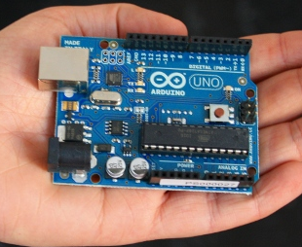
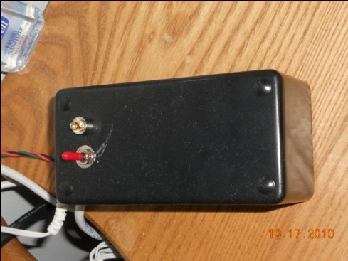
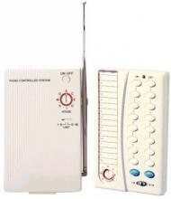
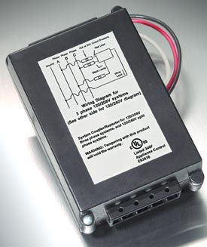
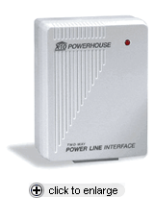
Other Sensors
Lizard Habitat Temperature
Maintaining a consistently high temperature is critical for the health of our pet Spiny Tailed Lizard.
Uses an Arduino with Network shield enclosed in a project box with an on/off switch and power LED.
Connects to an LM34 temperature sensor
Allows Watchdog to query the platform and get the temperature over a CAT5 cable.
If the temp drops below 83 degrees F, Watchdog speaks a warning hourly until the temperature increases to a safe range.
192.168.1.198 Port 8888
Light Controls
Uses standard X10 lamp modules to turn on/off lights throughout the house.
Includes remote controls for manual over-ride.
Uses PSC04 module to interface to a PC serial port.
INSTEON ToggleLink relay wall switches were used to control the front door and garage coach lights. These are X10 backwards compatible.
An X10 Signal Coupler Repeater was installed to boost the X10 signals and overcome the 2-phase power wiring in the house.

Slide 20
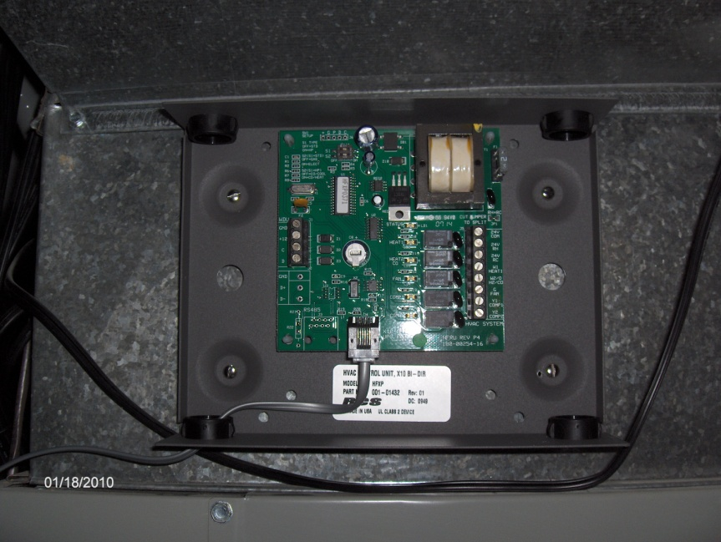
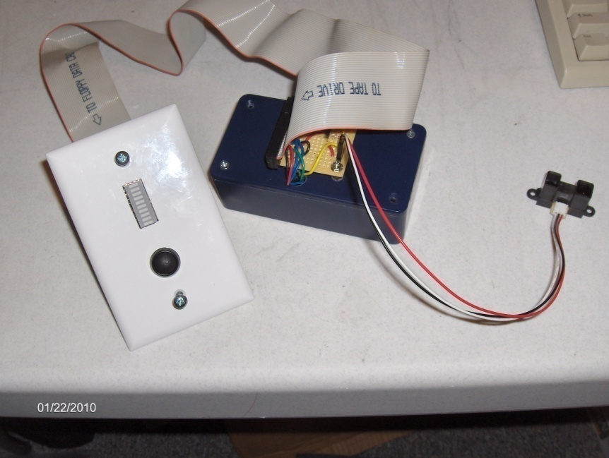
Other Sensors
X10 Thermostat:
Residential Control System (RCS) TXB16
X10 bi-directional system
Works with the TS16 Wall Display Unit (WDU)
Uses House Code “F”
Brine Tank Sensor
Custom wall plate with 10-LED Red/Yellow/Green display and momentary push-button.
The project box has an Arduino Duemilanove which has an Amtel ATmega328 Microprocessor that does the analog-to-digital conversion and logic for the LED lights. Stacked on top is an Arduino Ethernet Shield required since the cable run is too far for a USB cable. Communication is done via simple TCP Sockets.
A Sharp GP2Y0D02YK Infrared Range Finder senses distances from 8” to 60”. This is mounted onto the lid of the brine tank.
192.168.1.199 port 8888

Slide 21
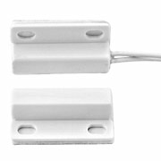
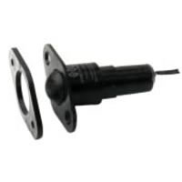
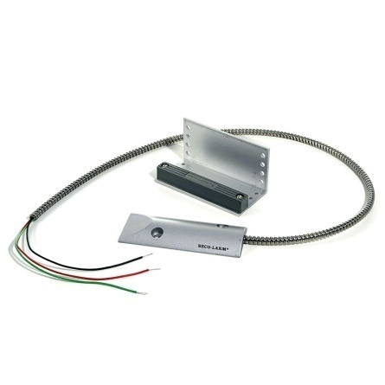
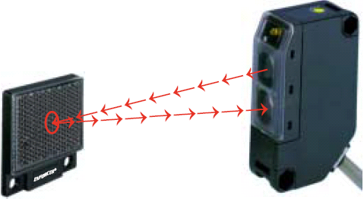
Other Sensors
Window Sensors:
Honeywell MPS-45WG
Sub-mini surface mount magnetic contact with exit leads
Door Sensor:
Roller Ball / Plunger Contact switch
Garage Door Sensor:
Seco-Larm ODC-59A
Magnetic
Car Park Sensor:
Seco-Larm Enforcer E-931-S35RR
Retroreflective Photoelectric Sensor

Slide 22
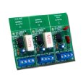
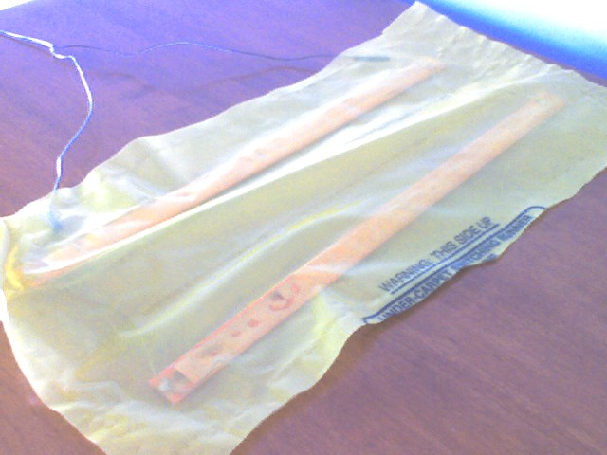
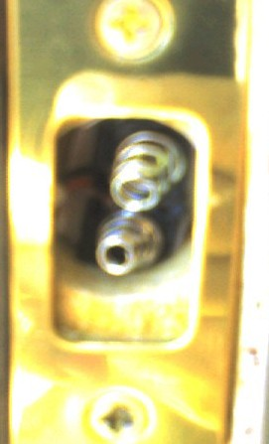
Other Sensors
Mailbox sensor:
Honeywell MPS-45WG
Sub-mini surface mount magnetic contact with exit leads
Doorbell & Telephone Sensor
ELK Doorbell & Telephone Ring Detector ELK-930
2 Telephone 1ines, 1 doorbell; Relay switch
Stair Sensor:
Weight sensor bars
Under rug on stairs going down to basement
Door Lock Sensor:
Custom deadbolt contact sensor with metal springs
Mounted on every external door

Slide 23
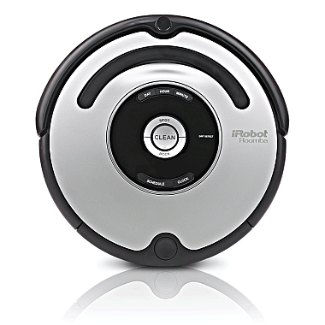
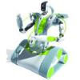

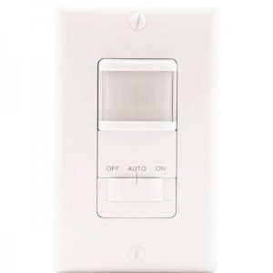
Non-integrated Features
Roomba:
iRobot Roomba 560
Automatically activates to sweep the hardwood floor in
the kitchen daily
Uses two “invisible gates” to prevent it from moving into other rooms.
Automatically docks and recharges
Spykee
Erector Spykee the spy robot
Remote controlled surveillance robot from house WiFi
Allows 2-way communication via integrated speakers and microphone
Allows playback of .MP3 files and sound effects.
Includes motion sensing features
Automatically docks and charges
Motion-sensing Garbage Can
iTouchless hands-free infrared automatic trash can
Senses presence and automatically opens lid of can
Automatically closes can after a short delay.
Motion-sensing Light switches
Automatically turns on/off lights
Bathrooms, Hallways

Slide 24
Appendix

Slide 25
X10 Channels
House Code | Channel | Description
G | 01 | Great room spider lamp
G | 02 | TBD
G | 03 | Front door coach lights
G | 04 | Garage door coach lights
House Code | Channel | Description
F | All | Thermostat Control
House Code | Channel | Description
E | 01-08 | Irrigation Zone 1 – 8 On/Off

Slide 26
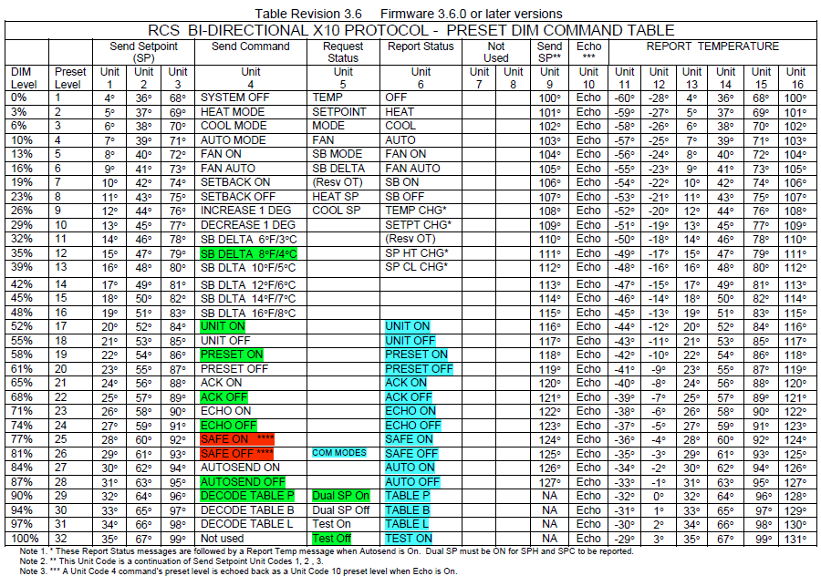
X10 Thermostat Control

Slide 27
Temp Sensor Connections
Board #1:
Measurement Computing USB-TEMP
 | Sensor
0 | Server Room
1 | Garage
2 | Kitchen
3 | Play Room
4 | Living Room
5 | Master Bedroom
6 | Sydney’s Bedroom
7 | Ethan’s Bedroom

Slide 28
DIO Sensor Connections
Board #2:
Measurement Computing USB-1024HLS
A | Sensor | B | Sensor | C | Sensor
0 | Kitchen Window | 0 | Living Room Front S | L0 | Mudroom Door Lock
1 | Back Door | 1 | Living Room Front C | L1 | Garage Window N
2 | Back Door Lock | 2 | Living Room Front N | L2 | Garage Window S
3 | Great Room Window N | 3 | Front Door | L3 | Garage Door
4 | Great Room Window S | 4 | Front Door Lock | H0 | Garage Outside Door
5 | Play Room Window N | 5 | Dining Room Window S | H1 | Garage Outside Door Lock
6 | Play Room Window S | 6 | Dining Room Window N | H2 | Mailbox
7 | Living Room Window S | 7 | Mudroom Door | H3
Board #3:
Measurement Computing USB-1024HLS
A | Sensor | B | Sensor | C | Sensor
0 | Master Bath Window | 0 | Basement Door | L0 | Telephone
1 | MBR Window S | 1 | Basement Door Lock | L1 | Car West
2 | MBR Window Back S | 2 | Basement Window S | L2 | Car East
3 | MBR Window Back N | 3 | Basement Window N | L3 | Basement Storage Door
4 | Sydney BR Window | 4 | Upstairs Hall Motion | H0 | Basement Motion
5 | Ethan BR Window | 5 | Server Room Motion | H1 | Exterior Motion
6 | Spare BR Window N | 6 | Great Room Motion | H2
7 | Spare BR Window S | 7 | Doorbell | H3

Slide 29
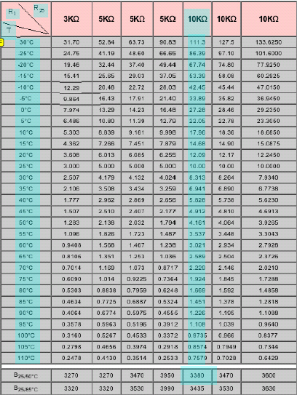


Temp Sensors
Cantherm Thermistor 10KΏ
Steinhart-hart equation for determining co-efficients:
Calculation:
A = 0.000545
B = 0.000305
C = 0

Slide 30
Event Codes
2001 | Garage Door Open
2002 | Garage Door Closed
2003 | Garage Window South Open
2004 | Garage Window South Closed
2005 | Garage Window North Open
2006 | Garage Window North Closed
2007 | Garage Outside Door Open
2008 | Garage Outside Door Closed
2009 | Garage Outside Locked
2010 | Garage Outside Unlocked
2011 | Garage Inside Door Open
2012 | Garage Inside Door Closed
2013 | Garage Inside Unlocked
2014 | Garage Inside Locked
2015 | Kitchen Window Open
2016 | Kitchen Window Closed
2017 | Back Door Open
2018 | Back Door Closed
2019 | Back Door Unlocked
2020 | Back Door Locked
2021 | Great Room Window North Open
2022 | Great Room Window North Closed
2023 | Great Room Window South Open
2024 | Great Room Window South Closed
2025 | Play Room Window North Open
2026 | Play Room Window North Closed
2027 | Play Room Window South Open
2028 | Play Room Window South Closed
2029 | Family Room Window South Open
2030 | Family Room Window South Closed
2031 | Family Room Window Front South Open
2032 | Family Room Window Front South Closed
2033 | Family Room Window Front Middle Open
2034 | Family Room Window Front Middle Closed
2035 | Family Room Window Front North Open
2036 | Family Room Window Front North Closed
2037 | Front Door Open
2038 | Front Door Closed
2039 | Front Door Unlocked
2040 | Front Door Locked
2041 | Dining Room Window South Open
2042 | Dining Room Window South Closed
2043 | Dining Room Window North Open
2044 | Dining Room Window North Closed

Slide 31
Event Codes
1001 | Basement Door Open
1002 | Basement Door Closed
1003 | Basement Door Unlocked
1004 | Basement Door Locked
1005 | Basement South Window Opened
1006 | Basement South Window Closed
1007 | Basement North Window Opened
1008 | Basement North Window Closed
1009 | Basement Storage Door Opened
1010 | Basement Storage Door Closed
5000 | Mail State Reset
5001 | Mail Delivered
5002 | Mail Retrieved
5003 | Doorbell Rang
5004 | Telephone Rang
5005 | Moms Car Arrived
5006 | Moms Car Departed
5007 | Dads Car Arrived
5008 | Dads Car Departed
5009 | Text Message Sent
5010 | Lights Turned On
5011 | Lights Turned Off
5012 | Vacation Mode Activated
5013 | Vacation Mode Deactivated
5014 | Intruder Detected
5015 | Welcome Home Greeting
5016 | Door Open Warning
5017 | Door Lock Warning
5018 | Upstairs Too Hot
5019 | Upstairs Too Cold
5020 | Main Level Too Hot
5021 | Main Level Too Cold
5022 | Server Room Too Hot
5023 | House is now Occupied
5024 | House is now Unoccupied
3001 | Master Bath Window Open
3002 | Master Bath Window Closed
3003 | Master Bedroom Window Back South Open
3004 | Master Bedroom Window Back South Closed
3005 | Master Bedroom Window Back North Open
3006 | Master Bedroom Window Back North Closed
3007 | Master Bedroom Window South Open
3008 | Master Bedroom Window South Closed
3009 | Guest Bedroom Window 1 Open
3010 | Guest Bedroom Window 1 Closed
3011 | Guest Bedroom Window 2 Open
3012 | Guest Bedroom Window 2 Closed
3013 | Ethan Bedroom Window Open
3014 | Ethan Bedroom Window Closed
3015 | Sydney Bedroom Window Open
3016 | Sydney Bedroom Window Closed

Slide 32
Event Codes
5025 | Brine Tank Low
5026 | Thermostat Set Point Raised
5027 | Thermostat Set Point Lowered
5028 | Thermostat Setback On
5029 | Thermostat Setback Off
5030 | Internet Connection re-activated
5031 | Internet Connection stopped
5032 | Lizard Habitat Too Cold Warning
5033 | Severe Weather Detected
5034 | Irrigation Zone 1 On
5035 | Irrigation Zone 1 Off
5036 | Irrigation Zone 2 On
5037 | Irrigation Zone 2 Off
5038 | Irrigation Zone 3 On
5039 | Irrigation Zone 3 Off
5040 | Irrigation Zone 4 On
5041 | Irrigation Zone 4 Off
5042 | Front Door Coach Lights On
5043 | Front Door Coach Lights Off
5044 | Garage Door Coach Lights On
5045 | Garage Door Coach Lights Off
6001 | Motion Detected in Server Room
6002 | Motion Detected in Upstairs Hallway
6003 | Motion Detected on the Main Level
6004 | Motion Detected in Basement
6005 | Motion Detected on Exterior Cameras
9001 | WDHouseUpdate Started
9002 | WDHouseUpdate Stopped
9003 | WDTempUpdate Started
9004 | WDTempUpdate Started
9005 | SARAH (Hallway) Started
9006 | SARAH (Hallway) Stopped
9007 | SARAH (Hallway) is Listening
9008 | SARAH (Hallway) is Sleeping
9009 | Irrigation Control Started
9010 | Irrigation Control Stopped
9011 | SARAH (MBR) Started
9012 | SARAH (MBR) Stopped
9013 | SARAH (MBR) is Listening
9014 | SARAH (MBR) is Sleeping
9015 | Irrigation Control Monitoring Started
9016 | Irrigation Control Monitoring Stopped
9999 | Error

Slide 33
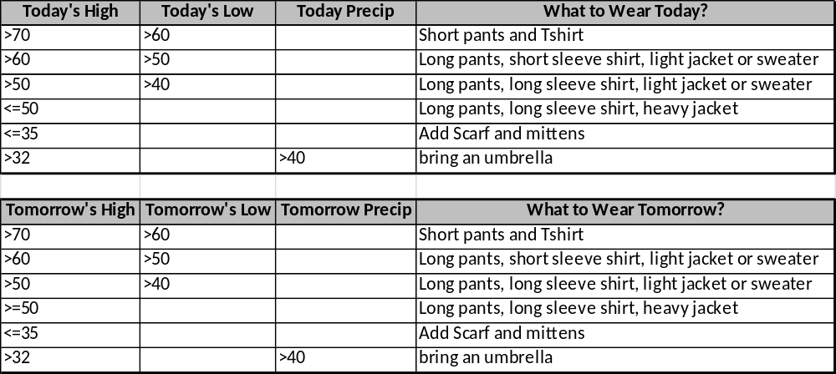
What to Wear?

